Slide 1
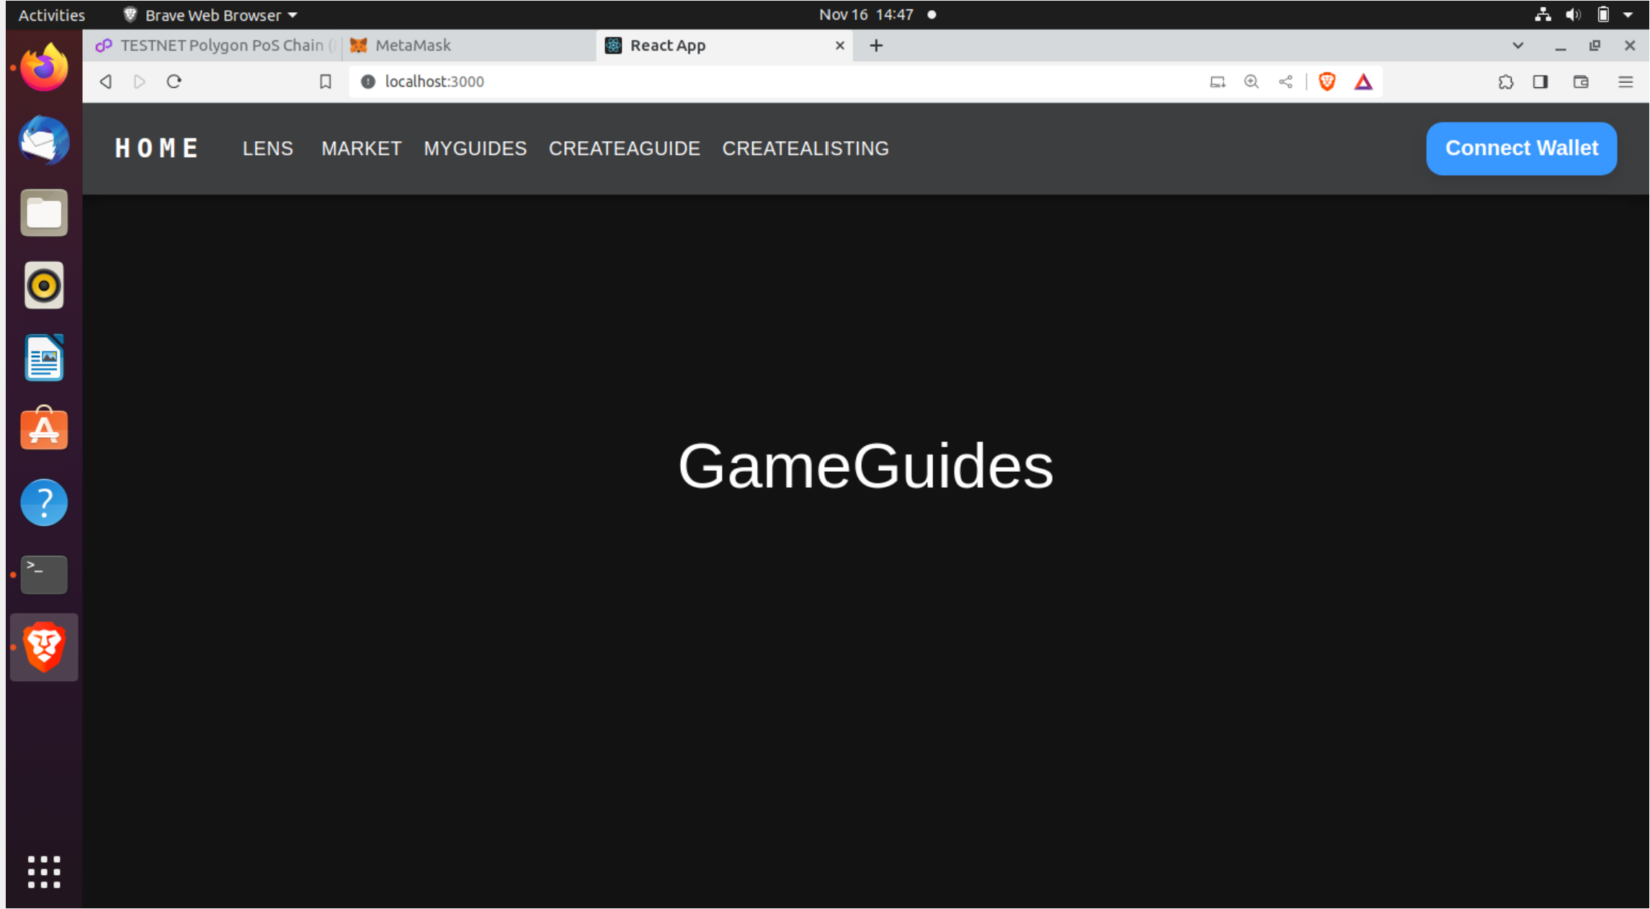

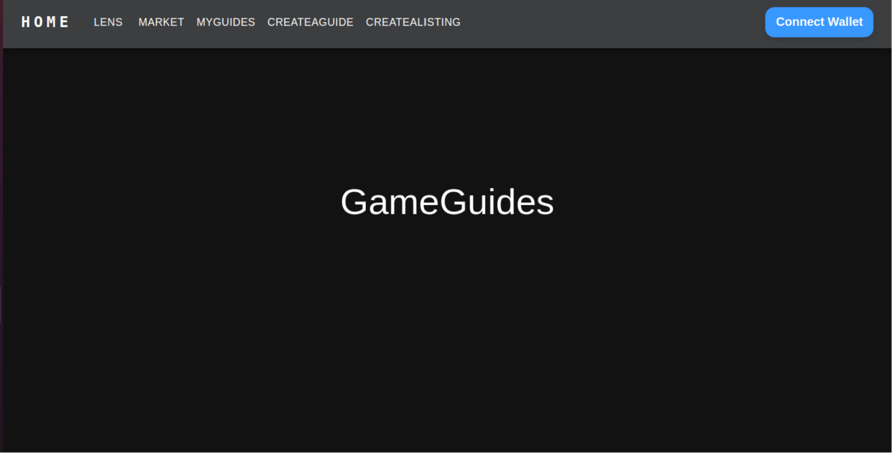
BLOCKCHAIN BASED SOCIAL MEDIA WITHOUT BOTS AND GAS FEES
MALLU VINEETHA.
HARSHITH KUMAR.
PRIYANKA K P.
HIRVA PATEL.

Slide 2
PURPOSE OF THE PROJECT:
The project aims to address several issues related to current social media platforms, including the ownership and selling of user data, the presence of fake accounts and bots, high gas fees associated with blockchain-based social media alternatives, the lack of producer-to-consumer interactions, and the low percentage of revenue generated by data producers.
To address these issues, the project proposes the use of Polygon Mumbai Blockchain to lower gas fees, a decentralized social graph called Lens-Protocol to ensure user ownership of data, token gating functionalities to facilitate producer-to-consumer interactions, and zero-knowledge identity and proof-of-personhood protocols to eliminate bots.
The project also intends to use smart contracts written in Solidity and a frontend built using Javascript and React.
Overall, the project seeks to create a more transparent and equitable social media platform that gives users more control over their data and facilitates direct interactions between producers and consumers.

Slide 3
USE OF BLOCKCHAIN IN PROJECT
The project proposes the use of Polygon Mumbai Blockchain to lower gas fees.
Decentralized social graph called Lens-protocol to ensure user ownership of data, token gating functionalities to facilitate producer to consumer interactions and proof of personhood protocols to eliminate bots.
This provides more transparent and equitable social media platform that gives users more control over their data and facilitates direct interactions between producers and consumers.

Slide 4
LITERATURE SURVEY
Research Paper: 1 Title: Blockchain-Based Identity Verification System. Publications: 2019, IEEE 9th International Conference on System engineering and technology,7th october 2019. Author: Arshad Jamal, Rabab Alayham Abbas Helmi, Mariam-Aisha Fatima and Ampuan Siti Nurin Syahirah - The research paper on a blockchain-based identity verification system presents a novel approach to secure and efficient identity verification. By utilizing blockchain and cryptographic techniques, the proposed system addresses the challenges of fraud and inefficiency in traditional identity verification methods. However, the concerns about Ethereum gas fees and storing sensitive user data on a public blockchain underscore the importance of addressing these issues in the proposed project.
Research Paper- 2 Title: Incentivized Blockchain-based Social Media Platforms: A Case Study of Steemit Publication-WebSci '19: Proceedings of the10th ACM Conference on WebScience, June 2019, pages145-154 Authors-Chao Li, Balaji Palanisamy - The study on incentivized blockchain-based social media platforms, such as Steemit, sheds light on the innovative ways blockchain can reshape social interactions. These platforms introduce a decentralized reward system, promoting high-quality content creation and user engagement. However, the shortcomings highlighted, such as bot networks and centralization concerns, emphasize the need for a more robust and secure solution.

Slide 5
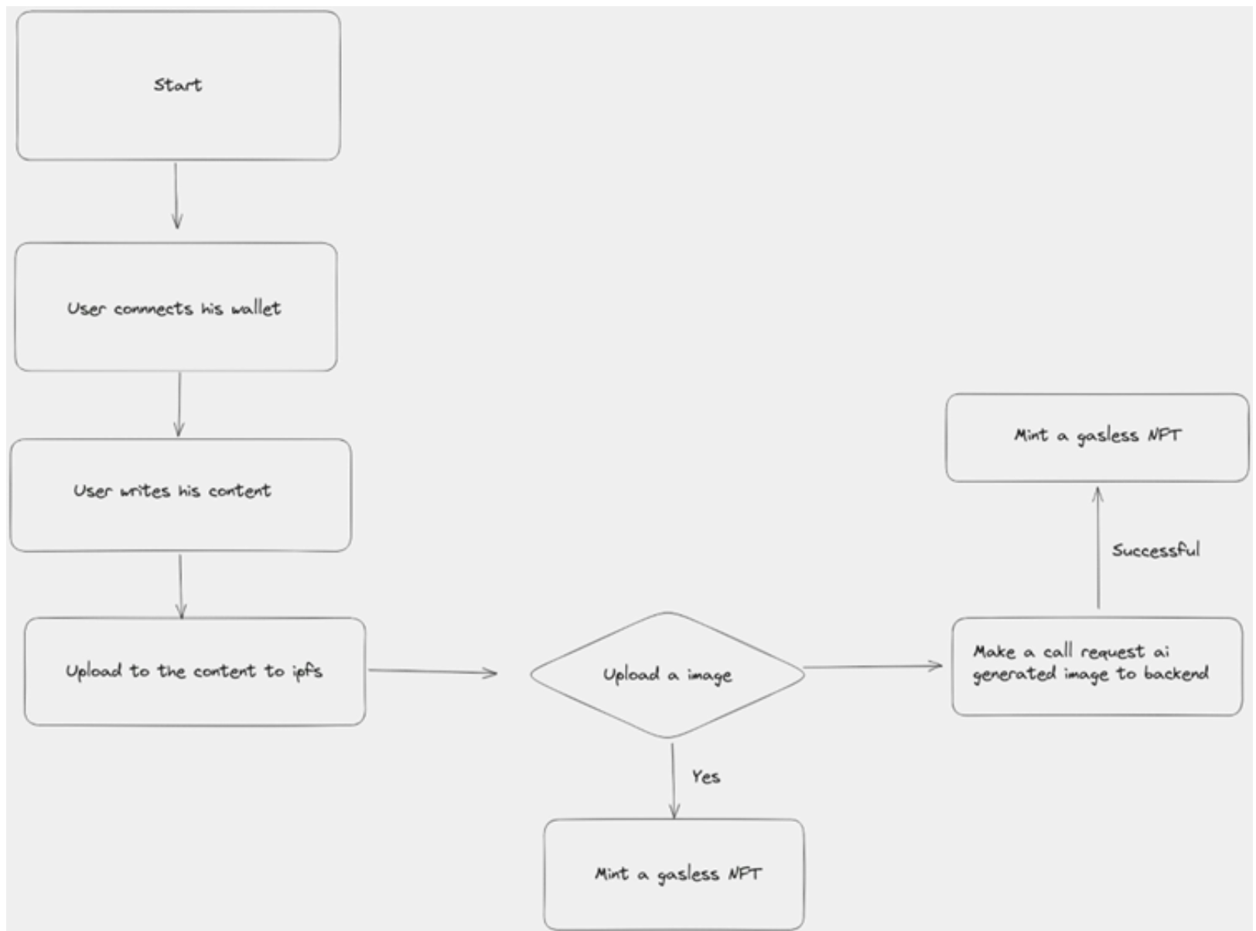
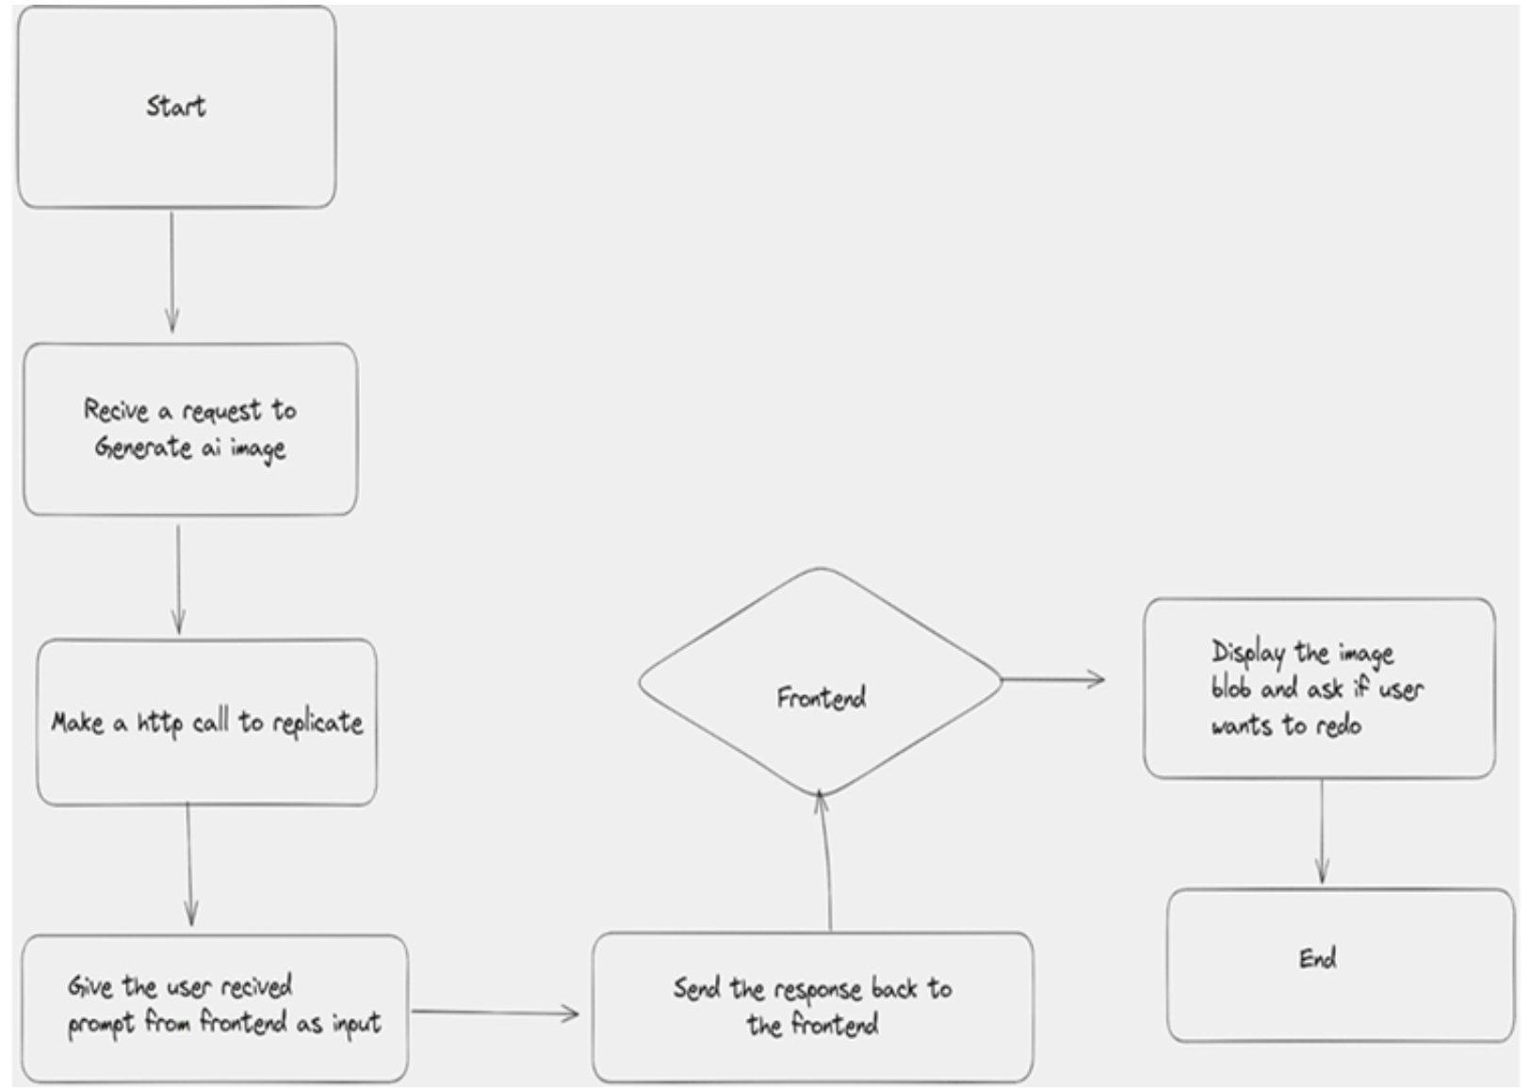
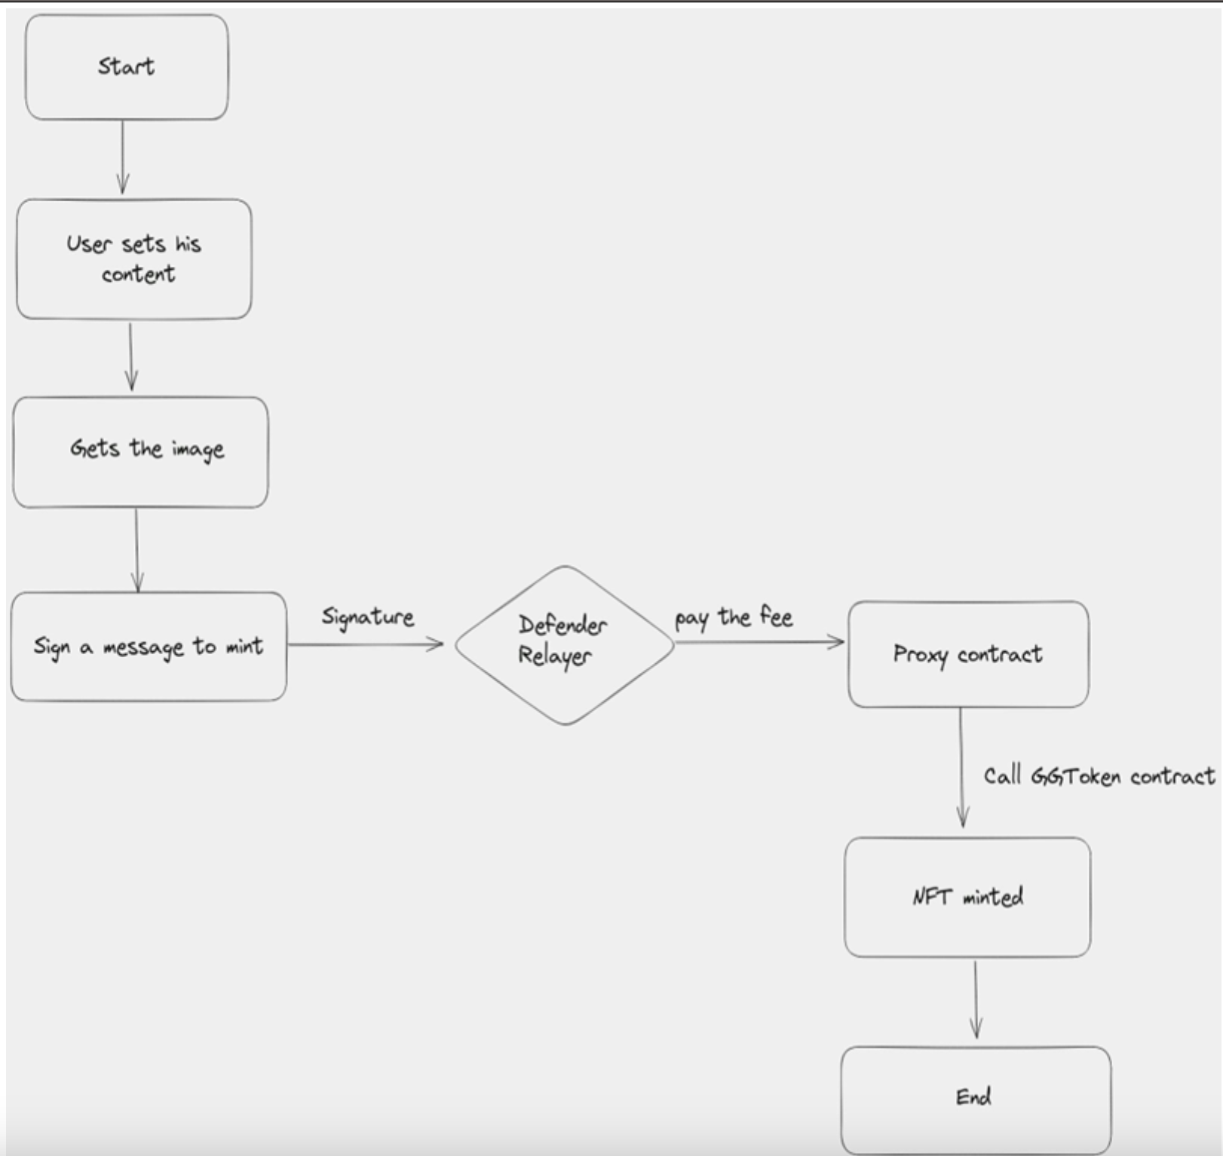
METHODOLOGY FLOW DIAGRAMS:

Slide 6
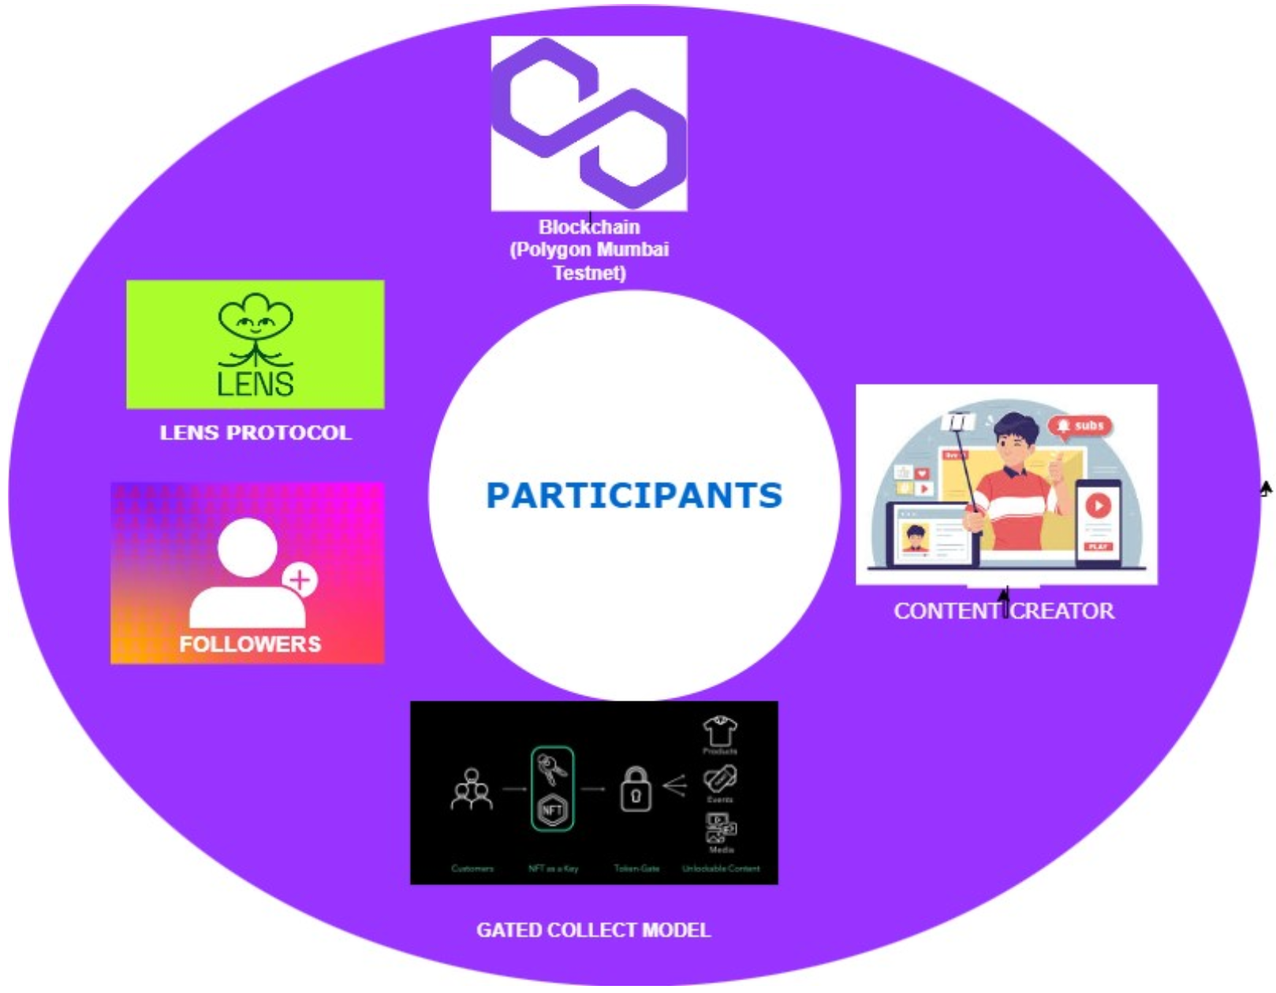
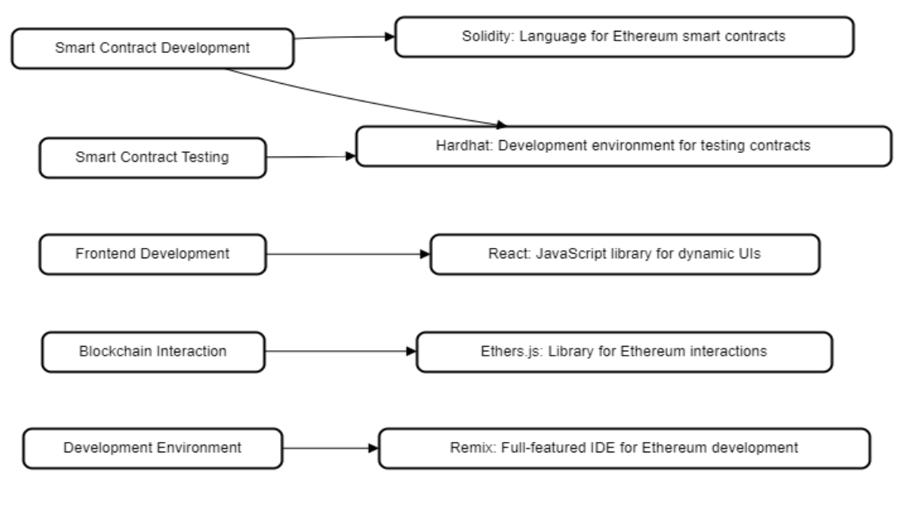
TECHNOLOGY STACK
PARTICIPANTS

Slide 7
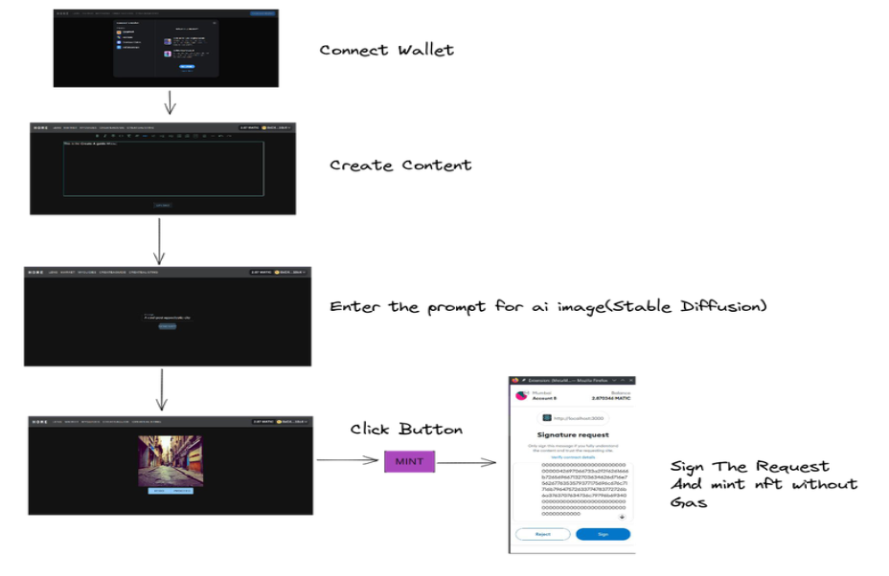
RESULTS:
The combination of Polygon Mumbai blockchain, Lens Protocol, Stable Diffusion and OpenZeppelin. Defender Relayer has provided a solid foundation for the platform and has the potential to revolutionize the social media industry.

Slide 8
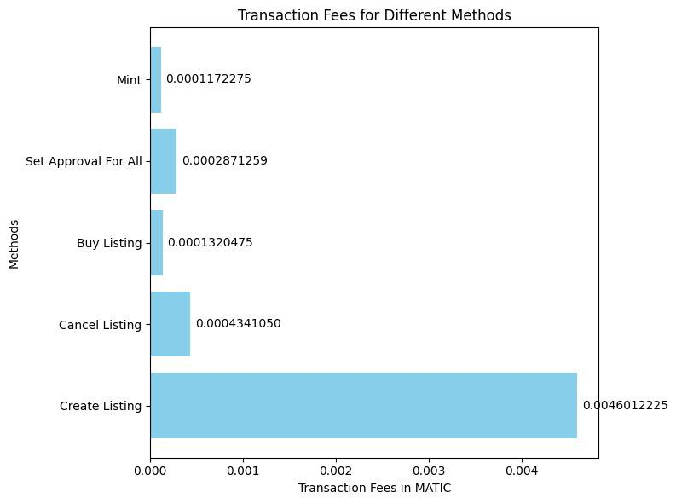
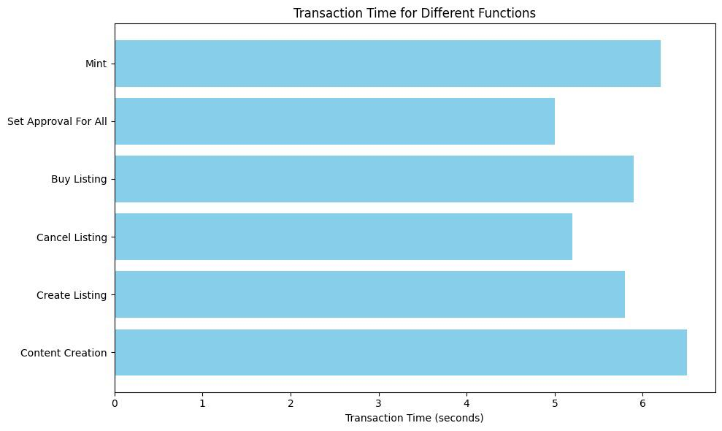
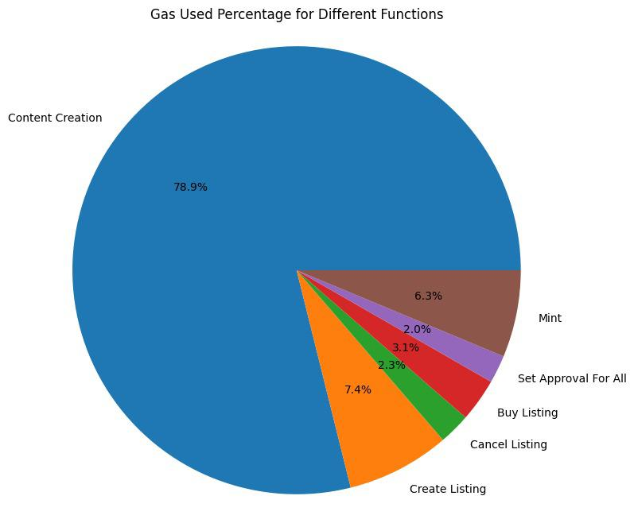
RESULTS

Slide 9
PROJECT OUTCOMES:
1. Secure and Decentralized Platform: Creating a secure and decentralized environment ensures user data protection, transparency, and resistance to censorship. It fosters trust among users and ensures the platform's availability.
2. User-Friendly Interface: A user-friendly interface, intuitive navigation, and appealing visuals enhance user experience. Features like user profiles, feeds, groups, and messaging contribute to an engaging platform.
3. Elimination of Gas Fees: Removing financial barriers by eliminating gas fees encourages inclusivity, allowing users from various economic backgrounds to participate equally.
4. Smart Contracts and Decentralized Identity Systems: Integrating smart contracts and decentralized identity systems helps in combating bots and fake accounts, ensuring genuine user interactions.
5. Monetization: Exploring revenue streams such as advertising or subscriptions ensures sustainable funding. It supports content creators and incentivizes meaningful engagement while maintaining the platform's viability.
6. Community-Driven Development: An open-source approach encourages collaboration and innovation. It allows for community contributions, fostering a diverse ecosystem of developers and users invested in the platform's growth.
These outcomes collectively create an environment that prioritizes user experience, security, inclusivity, and sustainability—a crucial foundation for a successful blockchain-based social media platform.

Slide 10
CONCLUSION:
In conclusion, the project has successfully addressed the problems of data ownership, and fair revenue distribution in social media platforms using blockchain technology.
The integration with Polygon Mumbai blockchain has provided a feasible solution to the problem of high gas fees.
The use of Lens Protocol has allowed users to retain ownership of their data and mint their posts as ERC1155 tokens, which can be sold on any marketplace, providing a fair revenue distribution model for content creators.
The use of Stable Diffusion has allowed to generate images from text.
The OpenZeppelin Defender Relayer has enabled gasless minting of ERC1155 tokens, reducing the barrier to entry for creators who are new to the blockchain space
Overall, the project has shown that blockchain-based social media platforms can provide a fairer revenue distribution model and data ownership for creators while providing a seamless user experience for users.

Slide 11
REFERENCES:
Research Paper- 1 Title: Incentivized Blockchain-based Social Media Platforms: A Case Study of Steemit Publication-WebSci '19: Proceedings of the10th ACM Conference on WebScience, June 2019, pages145-154 Authors-Chao Li, Balaji Palanisamy - https://dl.acm.org/doi/10.1145/3292522.3326041
Title: Blockchain-Based Identity Verification System. Publications: 2019, IEEE 9th International Conference on System engineering and technology,7th october 2019. Author: Arshad Jamal, Rabab Alayham Abbas Helmi, Mariam-Aisha Fatima and Ampuan Siti Nurin Syahirah - https://ieeexplore.ieee.org/document/8906403

